Slide 1
Automatic Craniotomy and Bonework via Milling, Force Sensing, and Impedance Sensing
Neuralink, US 2023/0165594, 6/1/2023
4/18/2024

Slide 2
About Craniotomy
Craniotomy – neurosurgical procedure of creating surgical perforation of cranium to access intracranial structures (brain)
Very time-consuming & high risk – requires manual cutting or drilling by a physician
Safety risks – requires perforation to be close to intracranial structures, causing damage to the intracranial structures
Accuracy – craniotomy not deep enough means insufficient access for signal
Consistency – irregular drilling surface may cause dimensions & angle of perforation relative to cranium
Very costly to hire physicians highly skilled physicians

Slide 3
Outline
Goal: Introduce an automatic craniotomy milling system using a computer numerical control (CNC) machine , via instructions from a controller based on input values from sensors detecting axial force of working tip and bio-impedance of patient
Embodiments:
Front perspective view of end effector of CNC machine
Rear perspective view of end effector of CNC machine
Bio-impedance measurement at various depths within cranium
System architecture of craniotomy milling system
2D view of a milling operation
3D view of a milling operation
Flowchart of performing a craniotomy
Flowchart of plunge milling a plurality of holes in cranium
Another flowchart of performing a craniotomy

Slide 4
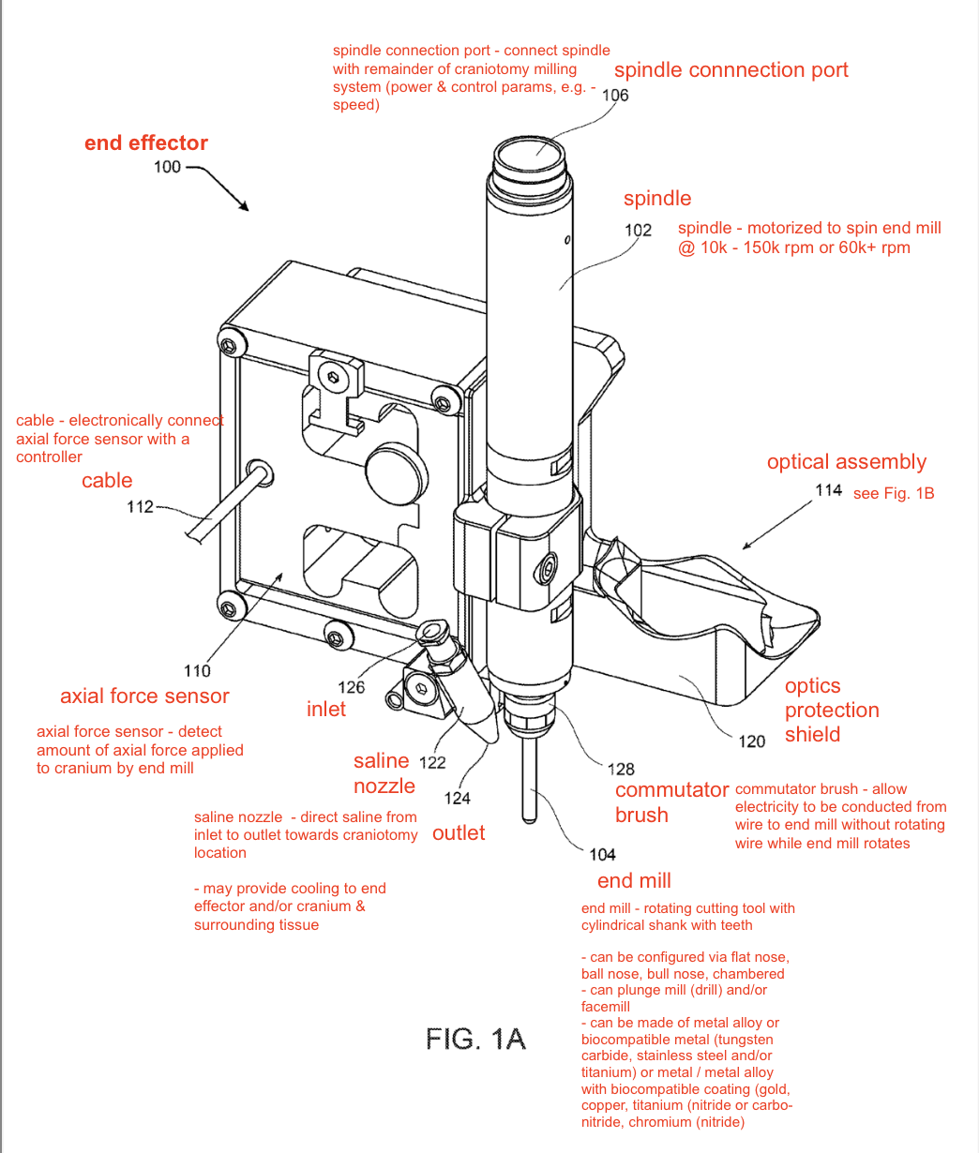
Front perspective view of end effector of CNC machine

Slide 5
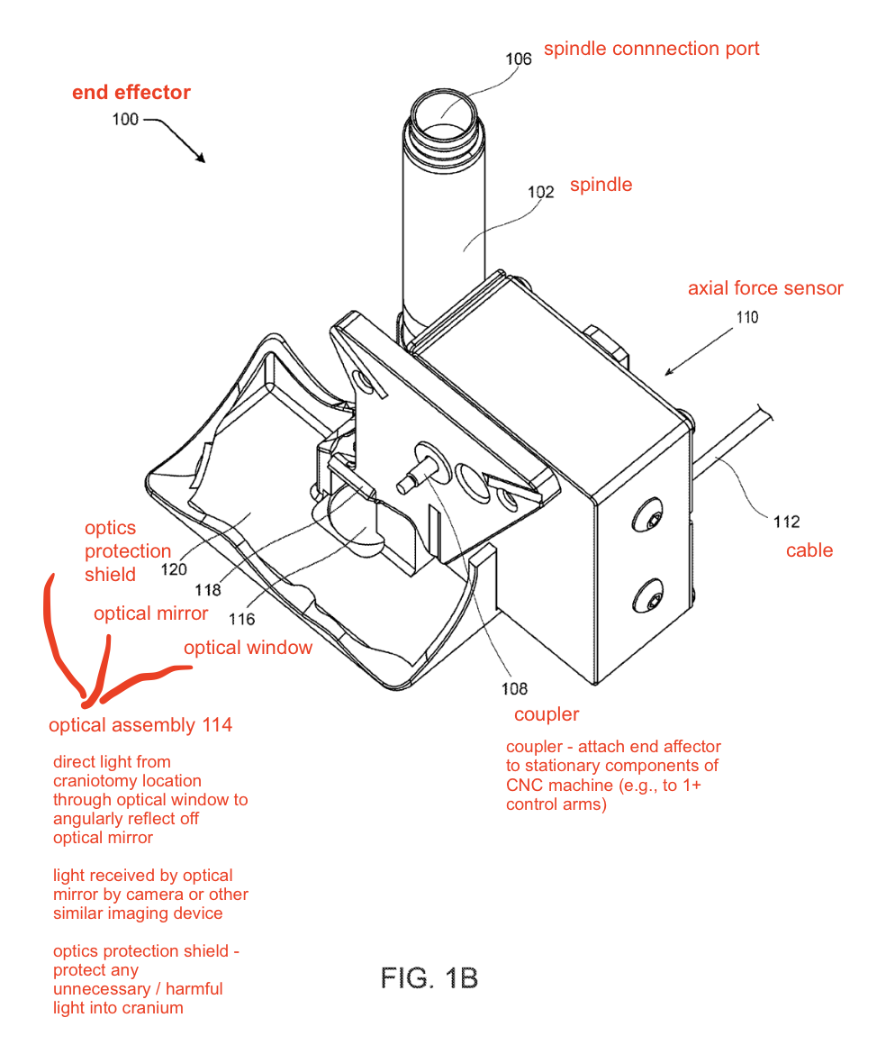
Rear perspective view of end effector of CNC machine

Slide 6
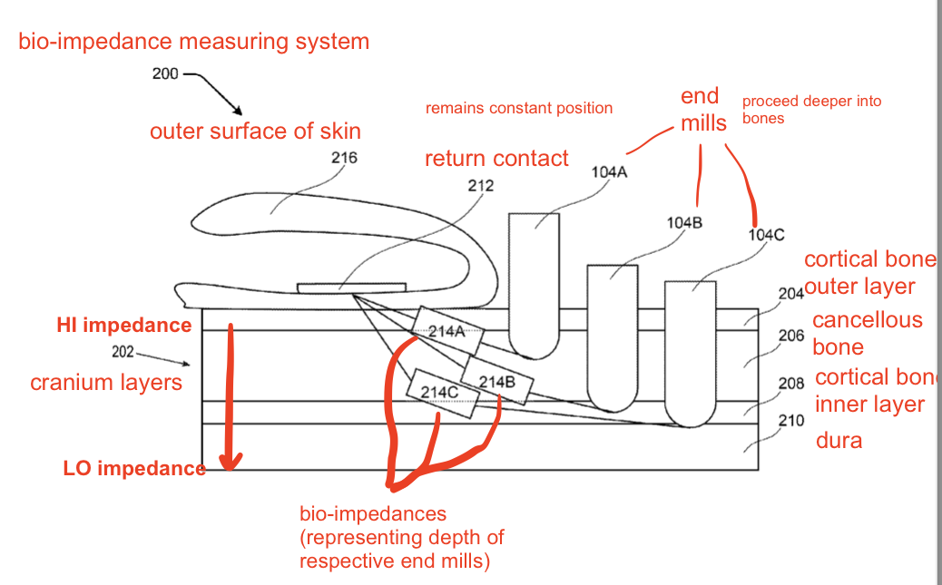
Bio-impedance measurement at various depths within cranium
High impedance – more force to drill (more “solid bone”)
Low impedance – less force to drill (more “fluid”)
Outer layers have higher impedance
Bio-impedance system – circuitry system
Power (A/C Voltage) source in mono-polar config
May include supply contact (anode) that couples to end mill
Supply contact in commutator brush
NOTE: Can measure raw impedance (with various components like commutator brush, end mill, return contact) or adjusted/scaled impedance

Slide 7
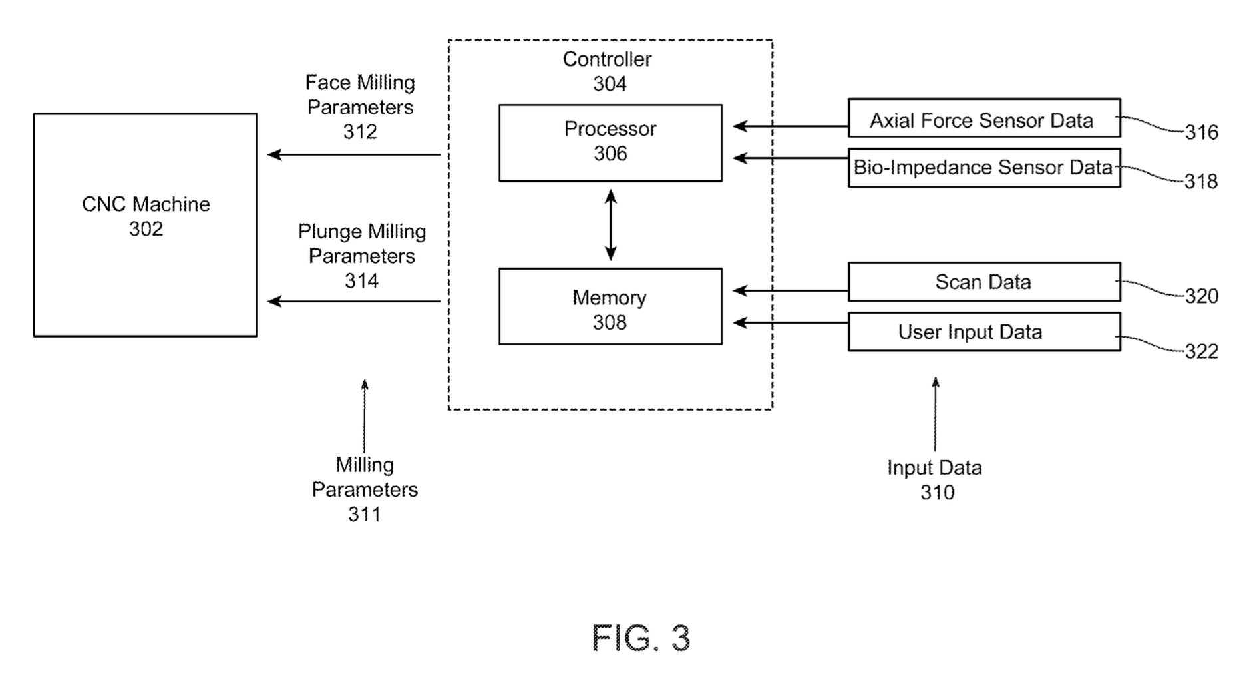
System architecture of craniotomy milling system

Slide 8
System architecture of craniotomy milling system
Key idea: STOP milling when you break through inner layer of cortical bone and reach the dura
How to tell CNC to “stop milling”?
→ change milling parameters
How can we accurately tell when to “stop milling”?
Multi-fault tolerance:
Can have multiple conditions from different input data - ANY condition satisfied warrants a stop
Check & compare multiple input data in processor for better consistency

Slide 9
System architecture of craniotomy milling system – axial force implementation 1
Input recent axial force sensor data (a) to processor via cable
Pass a to memory
Memory stores:
Historical axial force data (a_h) from other patients
A range [a_min, a_max] from current operation
Processor appends a to current axial force data
Compare a with a_h OR a from previous iteration → Determine depth d of end mill
Stop CNC milling (adjust milling params) when desired depth d is reached

Slide 10
System architecture of craniotomy milling system – axial force implementation 2
Input recent axial force sensor data (a) to processor via cable
Pass a to memory
Memory stores:
Historical axial force data (a_h) from other patients
A range [a_min, a_max] from current operation
Processor calculates range of axial force data [a_min, a_max] in current milling action
Stop CNC milling (adjust milling params) when a < 80-90% of a_max OR when a < a_min

Slide 11
System architecture of craniotomy milling system – bio-impedance implementation
Input recent bio-impedance sensor data (i) from bio-impedance measuring system to processor
Pass i to memory
Memory stores
Historical impedance data (i_h) from other patients
Current impedance data (i) for current operation
Processor appends i to current impedance data
Compare i with i_h OR i from previous iteration → Determine depth d of end mill
Stop CNC milling (adjust milling params) when desired depth d is reached
Bio-impedance sensor data – between return contact and supply contact on end effector

Slide 12
System architecture of craniotomy milling system – Overall implementation
Scan data - performed as a scan BEFORE craniotomy on the patient (patient-specific)
e.g., CT scan, ultrasound, etc.
User input data - from physician / doctor, inputted before OR during craniotomy
e.g., milling params, historical axial force / bio-impedance from previous procedures, CNC machine params like end mill type & size

Slide 13
System architecture of craniotomy milling system – Overall implementation
Input patient’s scan data, user input data into memory
Input axial force sensor data (a) & bio-impedance sensor data (i) into processor
Memory stores:
Historical axial force data (a_h) from other patients
A range [a_min, a_max] from current operation
Historical impedance data (i_h) from other patients
Current impedance data (i) for current operation
If ANY of these conditions are satisfied:
Axial force out of specified range of current milling
LARGE change of axial force
Axial force has reached desired depth
Bio-impedance has reached desired depth
Bio-impedance very different from historical data
LARGE change of bio-impedance
STOP the milling

Slide 14
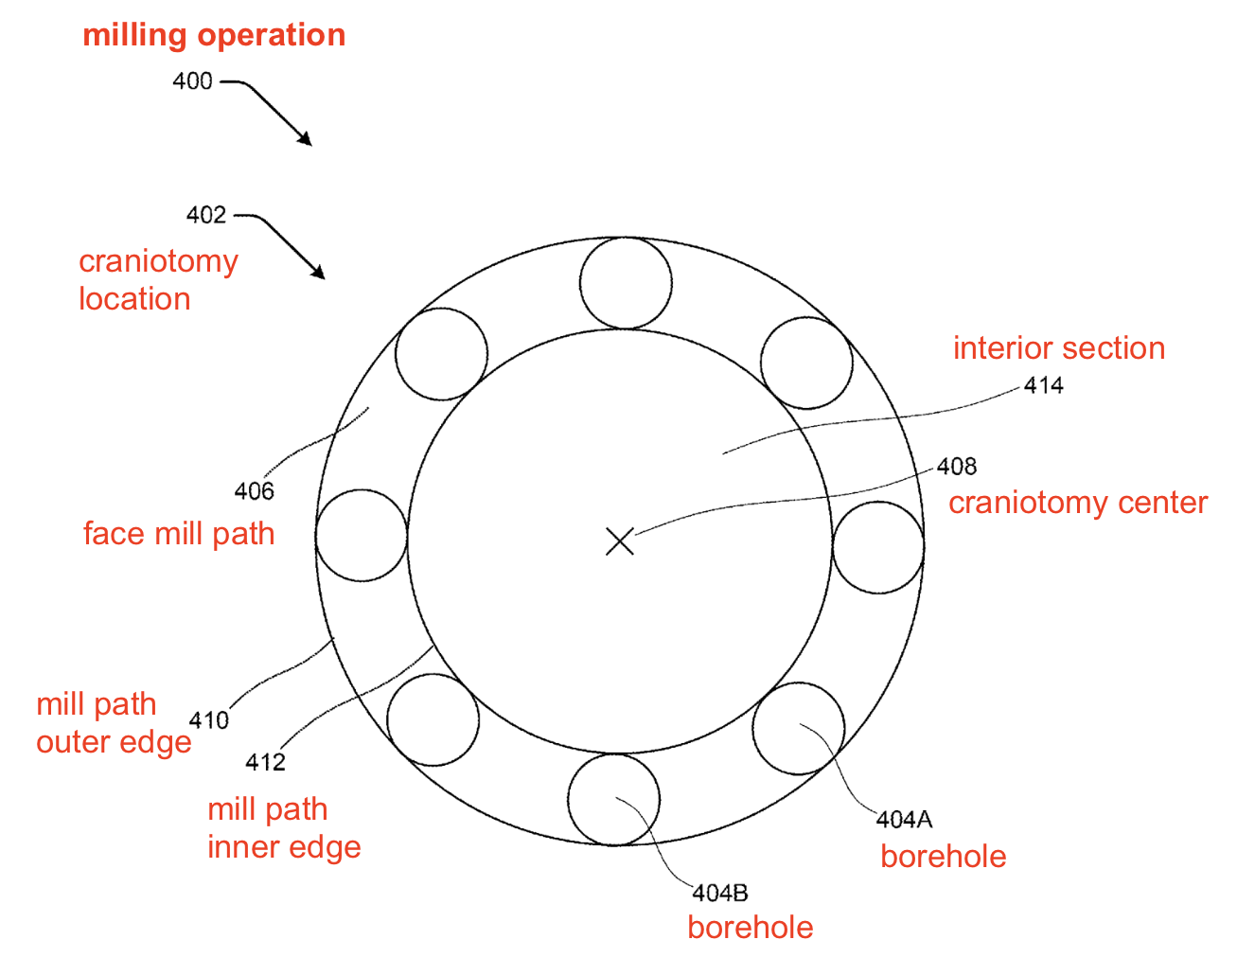
2D view of a milling operation
Need multiple milling tasks to ensure better precision & accuracy (allowing varying depths at various locations)
# of boreholes, # of milling operations, radius from craniotomy center – preselected via user input data
Face mill path shape can also be oval, rectangular, etc.

Slide 15
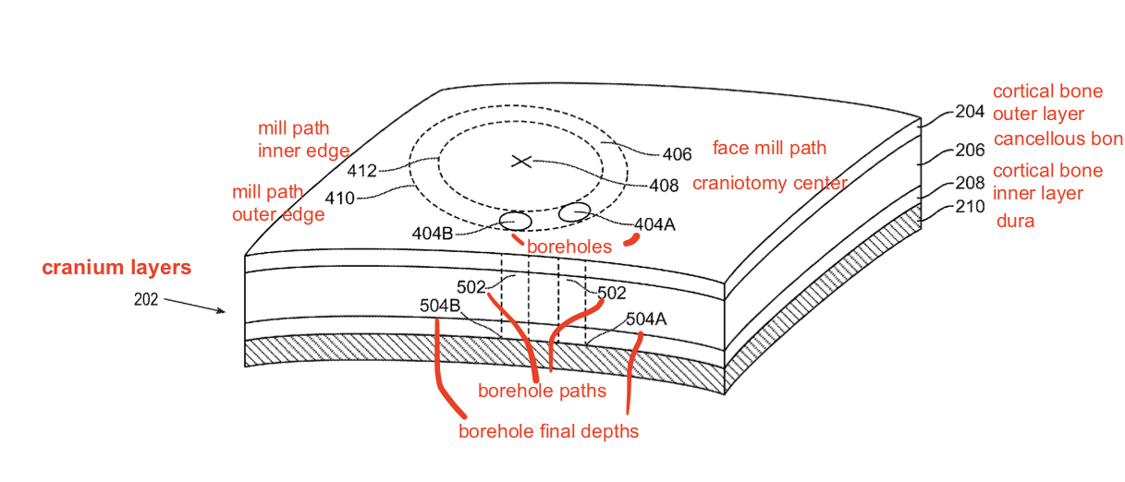
3D view of a milling operation
Boreholes form borehole paths with borehole final depths
Borehole final depths – determined by processor based on input data

Slide 16
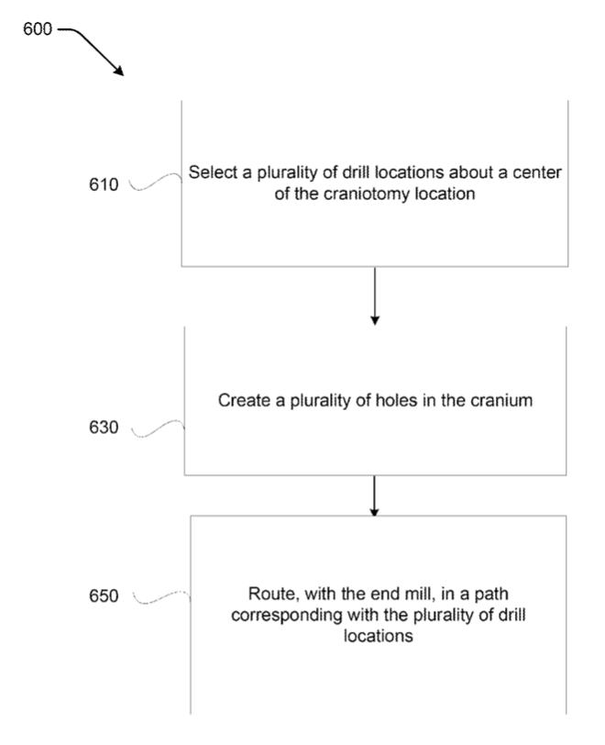
Flowchart of performing a craniotomy

Slide 17


Step 1:
Drill locations
X
Craniotomy center

Slide 18
Step 2:
Holes
X

Slide 19
Step 3:
X
Face mill path

Slide 20
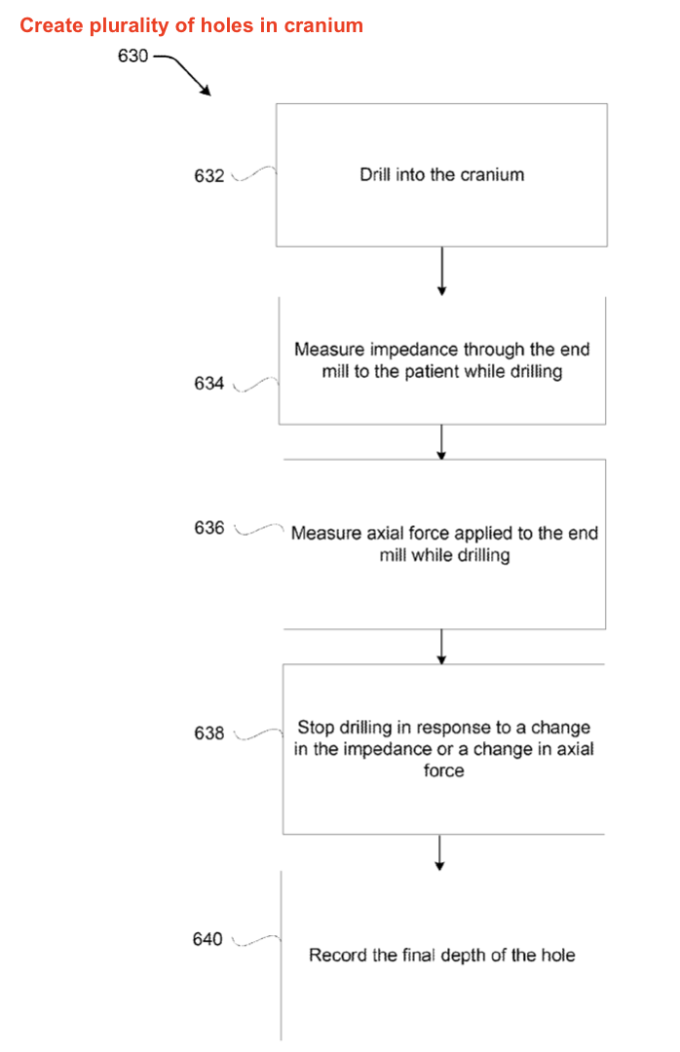
Flowchart of plunge milling a plurality of holes in cranium

Slide 21
Step 1:

Slide 22
Step 2:
Bio-impedance

Slide 23

Step 3:
Axial force sensor
Controller

Slide 24


Step 4:
Impedance OR axial force change stop condition reached?
→ STOP!!
Controller

Slide 25
Step 5:
Final depth recorded in memory

Slide 26
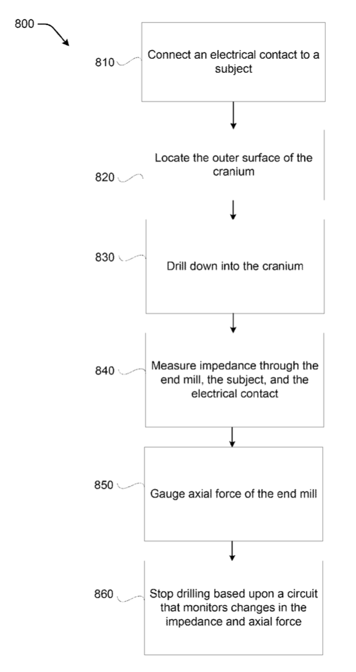
Another flowchart of performing a craniotomy

Slide 27

Step 1:
Electrical contact

Slide 28

Step 2:
Outer surface of cranium

Slide 29

Step 3:

Slide 30



Step 4:
Bio-impedance

Slide 31

Step 5:
Axial force sensor
Controller

Slide 32


Step 6:
Axial force sensor
Impedance OR axial force change stop condition reached?
→ STOP!!
Controller

